Slide 1
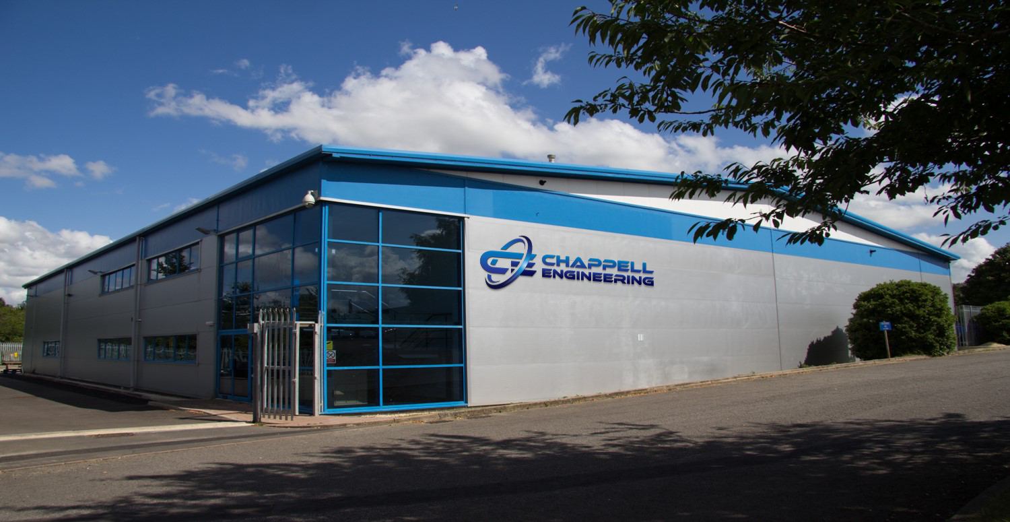
Factory Picture
SUPPLIER HANDBOOK v3 2022

Slide 2
CONTENTS
CHAPPELL ENGINEERING: SUPPLIER HANDBOOK. Revision 3: March 2020
INTRODUCTION
OVERVIEW
REQUIREMENTS & EXPECTATIONS

Slide 3
INTRODUCTION

Slide 4
INTRODUCTION
Introduction
Welcome! This hand book is intended to provide a brief overview of Chappell Engineering. It provides some background information on the company and its history. It also provides important information with respect to the expectations of Chappell Engineering regarding its Suppliers.
Traditional Values, Tomorrows Technology.
This motto summarises the philosophy of Chappell Engineering. The company has a long tradition of supplying high precision engineered parts to customers with the most demanding expectations. Despite numerous market challenges it has always survived and thrived.
This has been achieved by ensuring continuous supply of high quality of products manufactured, excellent delivery performance supported by a platform of unrivalled knowledge and the continuous investment in tomorrows technology to ensure Chappell Engineering stay at the front of pack when it comes to customer selection.
As part of the Chappell Engineering Supplier Team it is expected that you will uphold this tradition by respecting its values and ensuring that the traditional values of trust, integrity, commitment and achievement are respected and that your relationship with Chappell Engineering will be a positive experience.

Slide 5
OVERVIEW : CHAPPELL ENGINEERING

Slide 6
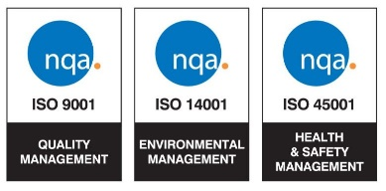
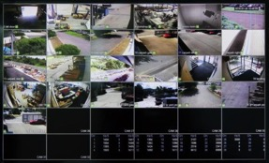
OVERVIEW: DEDICATON
Overview:
The following provides a brief overview of Chappell Engineering
100% dedicated to Customers serving approximately 50 accounts worldwide.
Long serving team with in-depth knowledge of Customer practices / procedures.
Chappell team embedded into the infrastructure of Customers providing value add on daily basis.
Understand and respect the Customer ethos of Quality, Cost, Delivery and Service.
Strong focus on Quality Assurance, Business Integrity, Security, Health & Safety, Environment and Continuity.
Chappell Engineering is a company built and sustained on a platform of family values where trust and commitment are paramount.
Continuous focus on the future and how to increase the scope of supply via turn key capability meeting the demands of its Customers.

Slide 7
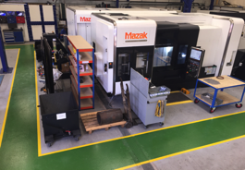
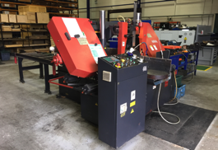
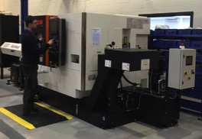
OVERVIEW: VERSATILITY
6M£+ investment in last 5 years : Facilities, Equipment and Personnel resource.
Focus on developing a machine platform targeted at versatility, speed and future proofing.
Progressively developing turnkey capabilities from material preparation, machining through to inspection and test.
Objective is to provide ‘one stop shop’ for Customers:
Rapid Response Times
Shorter Lead-times
Broader capabilities enabling bundled supply contracts
Single Point of ownership and responsibility
Reduced administrative burden.
Machine portfolio selected with scope of supply in mind. Flexibility enables wider product portfolio.
Leading brands selected for machine quality, reliability and service. Up time is critical.

Slide 8
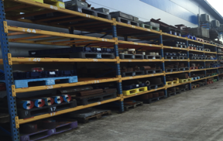
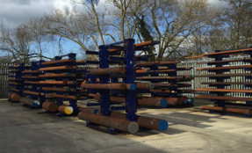
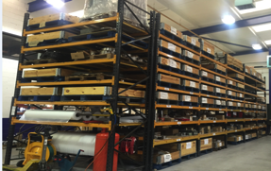
OVERVIEW: COMMITMENT
1.25M£ raw material inventory held at Chappell Engineering’s risk to remove supply chain risk.
1.0M£ in semi-finished / finished goods held in stock at Chappell risk for Customers to enable rapid turnaround.
Chappell philosophy to maintain risk / safety stock of Customer frequently ordered parts enabling very short delivery cycle.
Commitment is based on trust, knowledge and close collaboration between Customer and Chappell Engineering.
Overrun production philosophy to generate additional ‘stock’ units ensuring cost competitiveness (set up costs) and short term availability.
Intelligent raw material purchasing and stock holding based on knowledge of material markets and pricing in volatile supply market (especially for exotic materials)

Slide 9
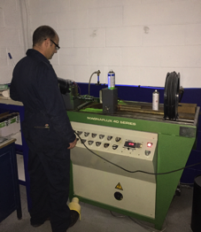
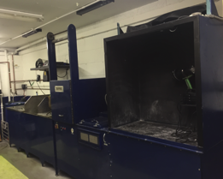
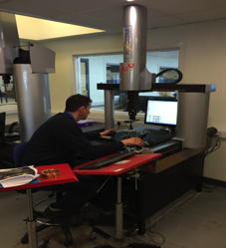
OVERVIEW: QUAITY & SERVICE
0.8M£ invested in Pressure Testing / Clean Room / Oil Flushing / NDE / Inspection & Test equipment and gauges.
Objective to ensure in-house capabilities for end to end inspection and test.
Removes reliance on third party services with consequential administrative and lead-time delays. Cost effective (avoids margin stacking)
Commitment to excellence encompassed by these investments. Ownership and responsibility from start to finish.
Training and development of inspection and test personnel skills key for expertise and for personal enrichment.
Continued focus on expansion of in-house capabilities. Current focus on developing pressure testing and certification preceded by ultrasonic cleaning and clean room assembly.

Slide 10
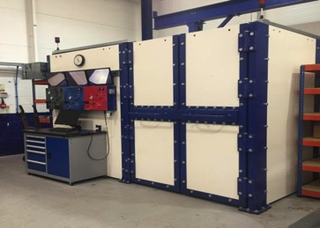
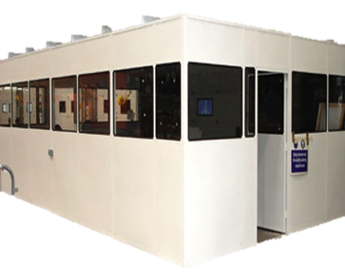
OVERVIEW: FURTHER INVESTMENT
Continuation of End-to-End capability for ‘one stop shop’ for Camerons:
Pressure test facility installed and certified in Chappell Engineering:
Hydrostatic
Nitrogen Gas
30,000 PSI
CCTV
Computerised Graphics
Large Test Tank (1.5x1.0M)
Submergible Camera
Clean Room Assembly Facility:
ISO.8 Classification
Positive Pressure Room
Oil Flushing
Targeted to provide complete assembly services to Customer procedures and specifications.
Further reduction in Customer supply chain complexity via provision of a trusted / proved ‘one stop shop’

Slide 11
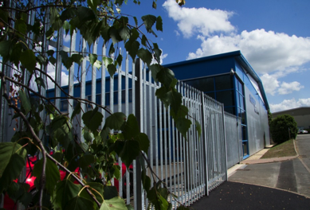
OVERVIEW: SUMMARY
Summary:
Chappell Engineering is 100% committed to its customers since 1990 as trusted Partner.
Vision to become a Turn Key Supplier to to key customers to optimise the supply chain.
Mutually beneficial relationship based on trust, commitment and knowledge.
Focus on understanding the changing / competitive environment of its customers.
Continuous adaption / expansion by Chappell Engineering to add maximum value to the Customer / Chappell relationship.
Understanding the competitive environment and adapting accordingly.

Slide 12
REQUIREMENT & EXPECTATIONS.

Slide 13
Requirements & expectations
WELCOME TO CHAPPELL ENGINEERING LTD!
To ensure the minimisation of costly errors / interruptions and difficulties please read the following carefully.
If you have any questions please ask your contact. Thank You

Slide 14
Requirements & expectations
STATUS
Receipt of this document indicates your status as a Chappell Engineering Approved Supplier. This is achieved via one or more of a number of factors:
Recommendation / Past History of Performance
ISO.9001 Certification Status
Approved Supplier to our Customer
As a consequence of physical audit / assessment
Please advise us without delay of any change in your company’s circumstances that has an impact on one or more of the criteria above.

Slide 15
Requirements & expectations
QUOTATIONS
Chappell Engineering will provide all necessary information to enable you as the supplier to provide a quotation for the product and / or service required.
Please ensure that you fully understand the requirements detailed in the quotation request or in the supporting information provided.
It is your responsibility to ensure an accurate quotation for the requirements specified. Also to confirm parameters such as delivery date and certification are understood and can be made.
Responses to requests to quotation will only be accepted in writing (e-mail / fax) . Verbal quotations must be followed up in writing.

Slide 16
IMPORTANT INFORMATION 1/1
IMPORTANT INFORMATION!
Chappell Engineering subscribes, as part of its ISO.9001 / AS.9100 certification, to a code of conduct which it, in turn expects its Suppliers to adhere to.
Subsequent pages detail critical topics to which adherence is considered to be mandatory. Any questions or concerns with respect to these topics should be addressed to Chappell Engineering
Any suspicion or retrospective discovery that brings into question the integrity of one or more of the following topics relative to parts or services supplied must immediately be brought to the attention of Chappell Engineering.

Slide 17
Requirements & expectations 1/5
Ethical Behaviour
Chappell Engineering expects that its suppliers behave in an ethical manner at all times and that the supplier maintains a culture whereby it actively encourages its workforce to undertake work in a conscientious, diligent manner whereby any deviations or errors identified are brought to the attention of management and addressed in a professional, transparent and timely manner.

Slide 18
Requirements & expectations 2/5
Product Conformity
Products supplied to Chappell Engineering are expected to conform in all aspects to the requirements specified in the Purchase Order. This includes the material specification, drawing requirements and any associated inspection / test requirements and post manufacturing processes. It is the responsibility of the supplier to ensure product conformity.
Where applicable, a Deviation / Concession request to permit a non-conformance from the specified requirements can be made to Chappell Engineering. Suppliers are strongly advised to ensure that, where possible, this is done proactively rather than after the event.
In the event that product non-conformance or risk of non-conformance is identified post despatch of the product to Chappell Engineering or its nominated destination, the supplier is expected to advise Chappell Engineering without delay of the actual or suspected non-conformance in order that remedial actions can be taken.

Slide 19
Requirements & expectations 3/5
Product & Personal Safety
Manufactured products are supplied into industries where safety is of paramount importance and the consequences of unsafe products are life threatening. The supplier must take actions that put in question the integrity of the product or the safety of its users by the undertaking processes or submitting parts that are knowingly not in conformance to the provided specifications.
Any concerns with respect to specified requirements that, in the experience of the supplier, maybe considered to be unsafe or give rise for concern should be brought to the attention of Chappell Engineering prior to commencement of manufacturing or processing activities in order that such concerns can be relayed back to Chappell Engineering’s customer for clarification.

Slide 20
Requirements & expectations 4/5
Counterfeit Parts
Chappell Engineering will normally provide material / product as part of the requirements for supplier activities. In the event that this is not the case or for the application of coatings etc, only industry approved sources of supply of known integrity and, where applicable, on the customer specified Approved Vendor List will be used.
The supplier will not use material or parts which are considered to be from a questionable source of supply or where there is any doubt as to the integrity of the material or product being procured. In the subsequent event that the integrity of the supply source is brought into question then Chappell Engineering must be informed accordingly and without delay in order that actions can be taken.

Slide 21
Requirements & expectations 5/5
Foreign Object Detection
Given the nature of the products Chappell Engineering supply and the industry applications where these are used, the necessity for the prevention of product contamination with foreign bodies is absolute.
Foreign objects can include swarf, oil, grease, packaging materials, clothing, tooling, measurement equipment or other object which is not specified in the applicable drawing or specification.
The supplier is expected to put in place measures that maximise the probability of foreign object detection during and post production / processing by the implementation of controls and checks to identify and remove such objects prior to release and despatch to Chappell Engineering.

Slide 22
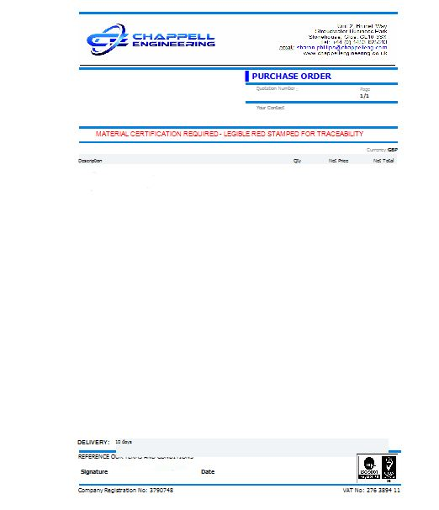
Requirements & expectations
JOB PACK 1/3
Chappell Engineering will provide a detailed Purchase Order (PO). This will provide information with respect to the product and services required.
Where applicable, the Purchase Order will made reference to particular material and / or process specifications that must be met. If required copies are provided.
The quantity required and any additional requirements relating to certification, inspection, test, packaging and despatch will be specified on the PO or supporting documents.
If in any doubt with respect to the requirements of the PO please do not speculate. Contact Chappell Engineering!

Slide 23
Requirements & expectations
JOB PACK 2/3
Where applicable, Chappell Engineering will provide a detailed drawing or drawings of the Product / Service required. This is referred to as an SK Drawing.
Please ensure that this drawing is clearly understood taking note of a specific / special requirements specified on the drawing such as surface finish, coating etc.
Drawings should be retained in legible condition throughout and returned to Chappell Engineering on completion of production / processing.
If in any doubt with respect to the requirements of the SK Drawing please do not speculate. Contact Chappell Engineering!

Slide 24
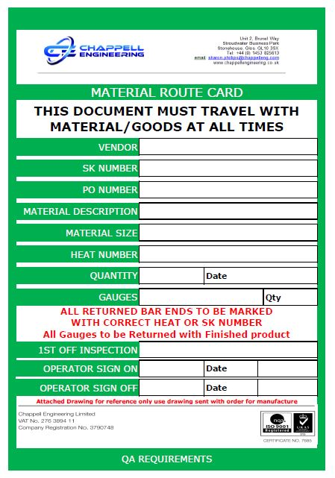
Requirements & expectations
JOB PACK 3/3
Where applicable, Chappell Engineering will provide a Material Route Card. This is an identifying traveller document and must accompany the product / material at all times
Please ensure that the requirements specified on the Material Route Card are met and that this is returned with the product back to Chappell Engineering.
Material Route Cards are also used to identify any accompanying material or gauging relative to the product / service required. This must also be returned unless otherwise agreed in writing.
If in any doubt with respect to the requirements of the SK Drawing please do not speculate. Contact Chappell Engineering!

Slide 25
Requirements & expectations
MATERIAL
Where applicable, Chappell Engineering will provide material for the product / service required. This must be considered as the property of Chappell Engineering at all times.
Any bar ends or residual material should be marked up in a manner that ensures its traceability to the original material provided and returned with the product to Chappell Engineering.
Any doubts with respect to the material should be reported to Chappell Engineering without delay in order that actions can be taken to address any problems identified.

Slide 26
Requirements & expectations
GAUGING / EQUIPMENT
Where applicable, Chappell Engineering will provide gauging or other equipment required to support the manufacturing / processing requirements.
All gauging / equipment must be considered as Chappell Engineering property and treated with care and respect to avoid damage or misuse.
On completion, all gauging / equipment provided must be returned to Chappell Engineering. Any damage incurred should be reported and you maybe liable for cost of repair or replacement.

Slide 27
Requirements & expectations
PROCESSING
Processing (manufacture of product and/or provision of service) must be undertaken in accordance with the specified requirements.
Any planned deviation from the processing requirements must be brought to the attention of Chappell Engineering in advance by means of a CONCESSION REQUEST.
Concession requests will be reviewed on a case by case basis and may often require consultation with Chappell Engineerings own customer prior to any approval being given. Approval will be given in writing.

Slide 28
Requirements & expectations
INSPECTION & TEST
As the supplier, Chappell Engineering expect you to provide product / service that fully meets the requirements specified in the PO and supporting documentation.
All necessary inspection and test activities will be performed to confirm the above. Where required this will be confirmed via documentary evidence such as an INSPECTION REPORT or TEST REPORT.
In the event that product or service is found to be non-compliant during inspection and test then Chappell Engineering should be informed without delay (see previous)

Slide 29
Requirements & expectations
PACKAGING
Following processing, product should be packaged in a manner that ensures it is not a risk of damage or deterioration during transit.
Where applicable, specific packaging requirements will be specified as part of the job pack information and packaging material maybe provided.
In all cases, the Supplier is expected to ensure that all reasonable care is taken to avoid damage during transit whether specific requirements are specified or not.
The Supplier may be held liable for product damaged in transit where it is clear reasonable care and attention was not applied.

Slide 30
HEALTH & SAFETY / SECURITY BRIEFING
CERTIFICATION
Where required, Product or Material certification will be requested. In such cases, specific requirements will be specified as part of the job pack.
The Supplier is responsible to ensure that all specified certification requirements are met and that the certification provides necessary traceability to the product / material / service provided.
Where required, certification will make reference to conformance to required specification and will ensure traceability to the gauging, test methods and test specification utilised.

Slide 31
HEALTH & SAFETY / SECURITY
DESPATCH
Products will be despatched in a timely manner in accordance with the required and agreed delivery requirements.
Packaged product will be clearly identified with the destination address as specified on the Purchase Order. Where applicable, despatch will be executed via a predefined carrier dependant on terms of supply.
Chappell Engineering should be informed by e-mail of the despatch of product and should be advised in advance of any issue / delay in the despatch process.

Slide 32
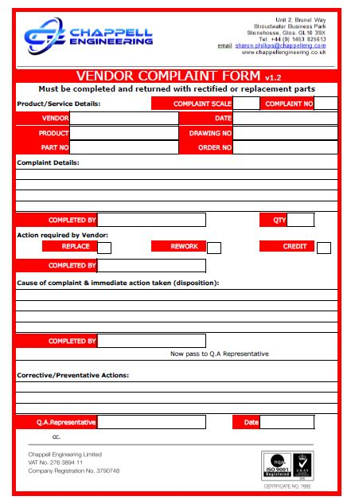
HEALTH & SAFETY / SECURITY
NON-CONFORMANCE
In the event of a non-conformance being raised against the Supplier in regard or the product or service required a VENDOR COMPLAINT FORM will be prepared and forwarded to you for you to review and complete.
Please ensure this form is fully and accurately completed detailing what went wrong, what actions have been taken to rectify the situation and, most importantly, what actions are being taken to prevent a recurrence.
Please note!
Failure to complete and return the Vendor Complaint Form or to support Chappell Engineering or its Customer with any subsequent investigation may result in the Supplier being removed from the Approved Supplier list of Chappell Engineering and / or its customer.

Slide 33
Requirements & expectations
SUPPLIER AUDIT
Where required, Chappell Engineering or its Customer may undertake a physical audit / inspection of the Suppliers facility and capabilities.
Such audits / inspections will be undertaken following notification but, in extreme circumstances, Chappell Engineering and its customers reserve the right to visit a short notice. This right can be extended to include sub-vendors / suppliers (of our Supplier).
During the course of an audit, processes and procedures will be examined. An Audit Report / Summary will be prepared. Actions required will be reviewed and agreed and timescales / responsibilities assigned.

Slide 34
Requirements & expectations
CAUTION!
Failure to comply with the requirements detailed in the previous pages of this handbook could result in removal of the Supplier as a Approved Supplier by Chappell Engineering or its Customer(s).
IF IN DOUBT ASK, DO NOT TAKE RISKS

Slide 35
Traditional Values, Tomorrow’s Technology

