Slide 1
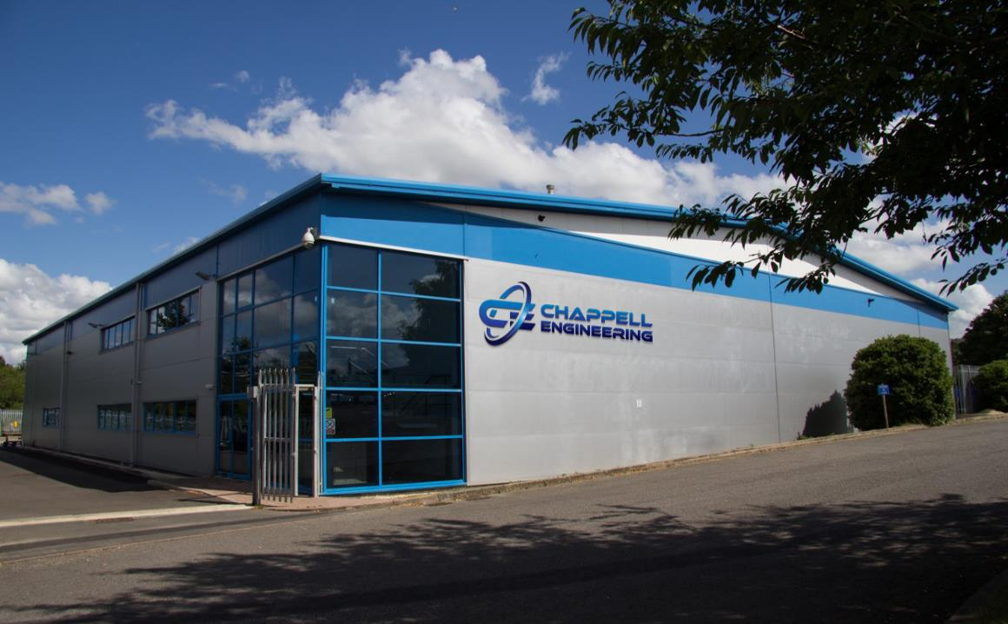
Unit 2 Brunel Way
Stroudwater Business Park
Stonehouse
Gloucestershire
GL10 3SX, United Kingdom
+44 (0) 1453 825 613
enquiries@chappelleng.com
www.chappelleng.com
ISO 9001: Certificate 7685
Traditional Values : Tomorrows Technology

Slide 2
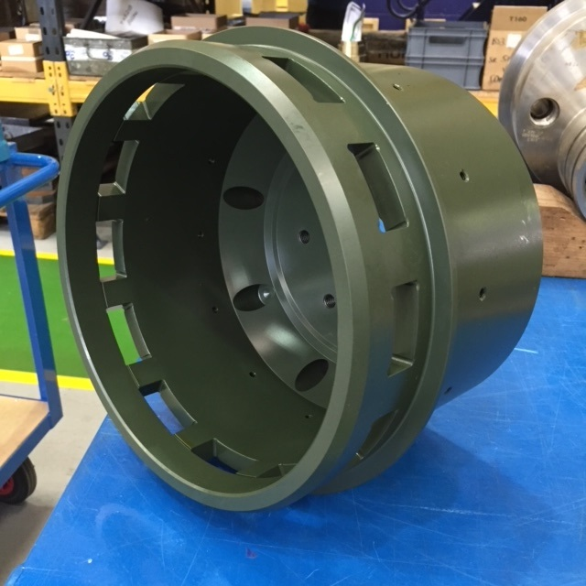
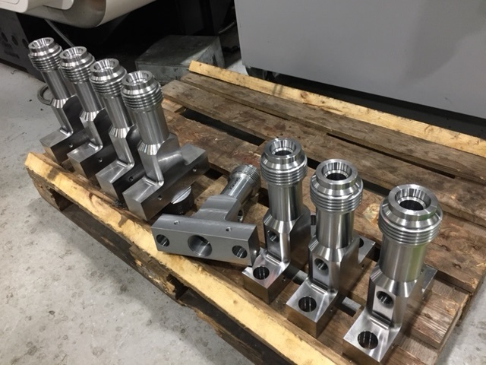
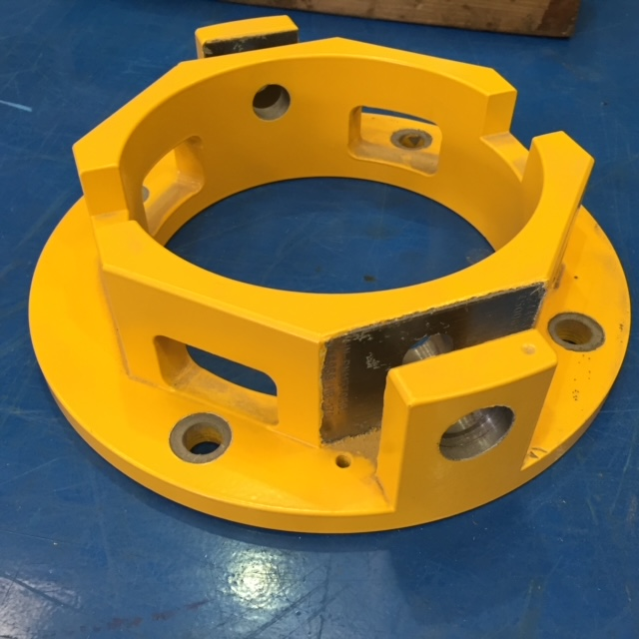
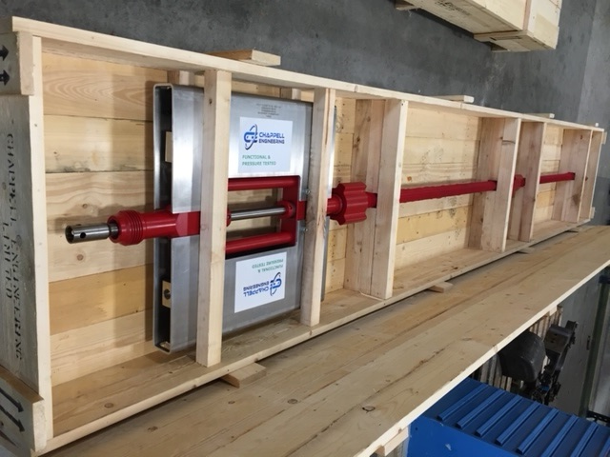
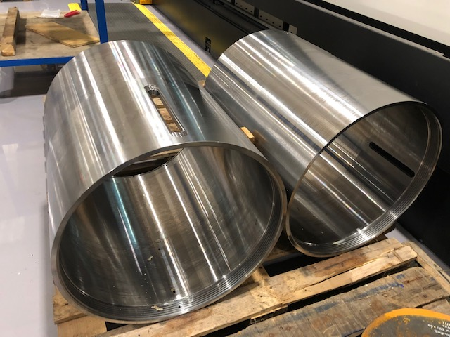
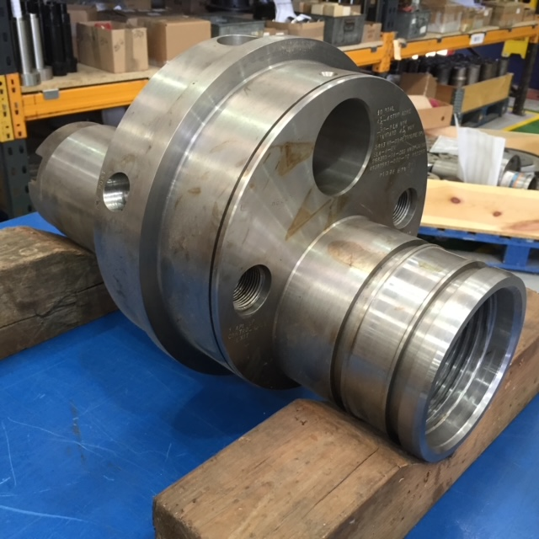
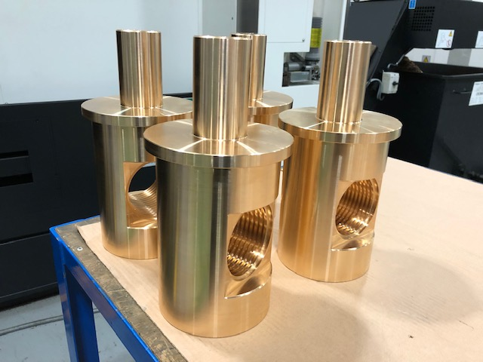
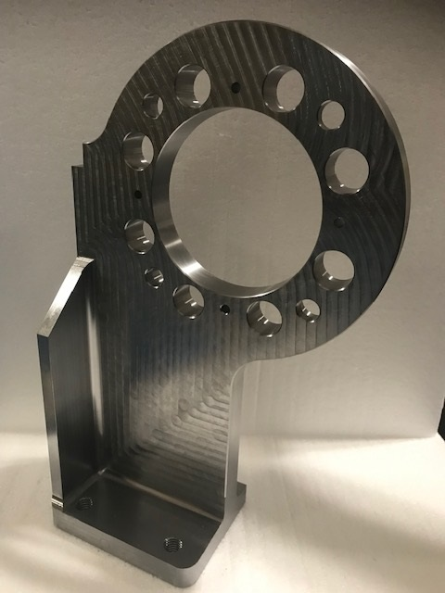
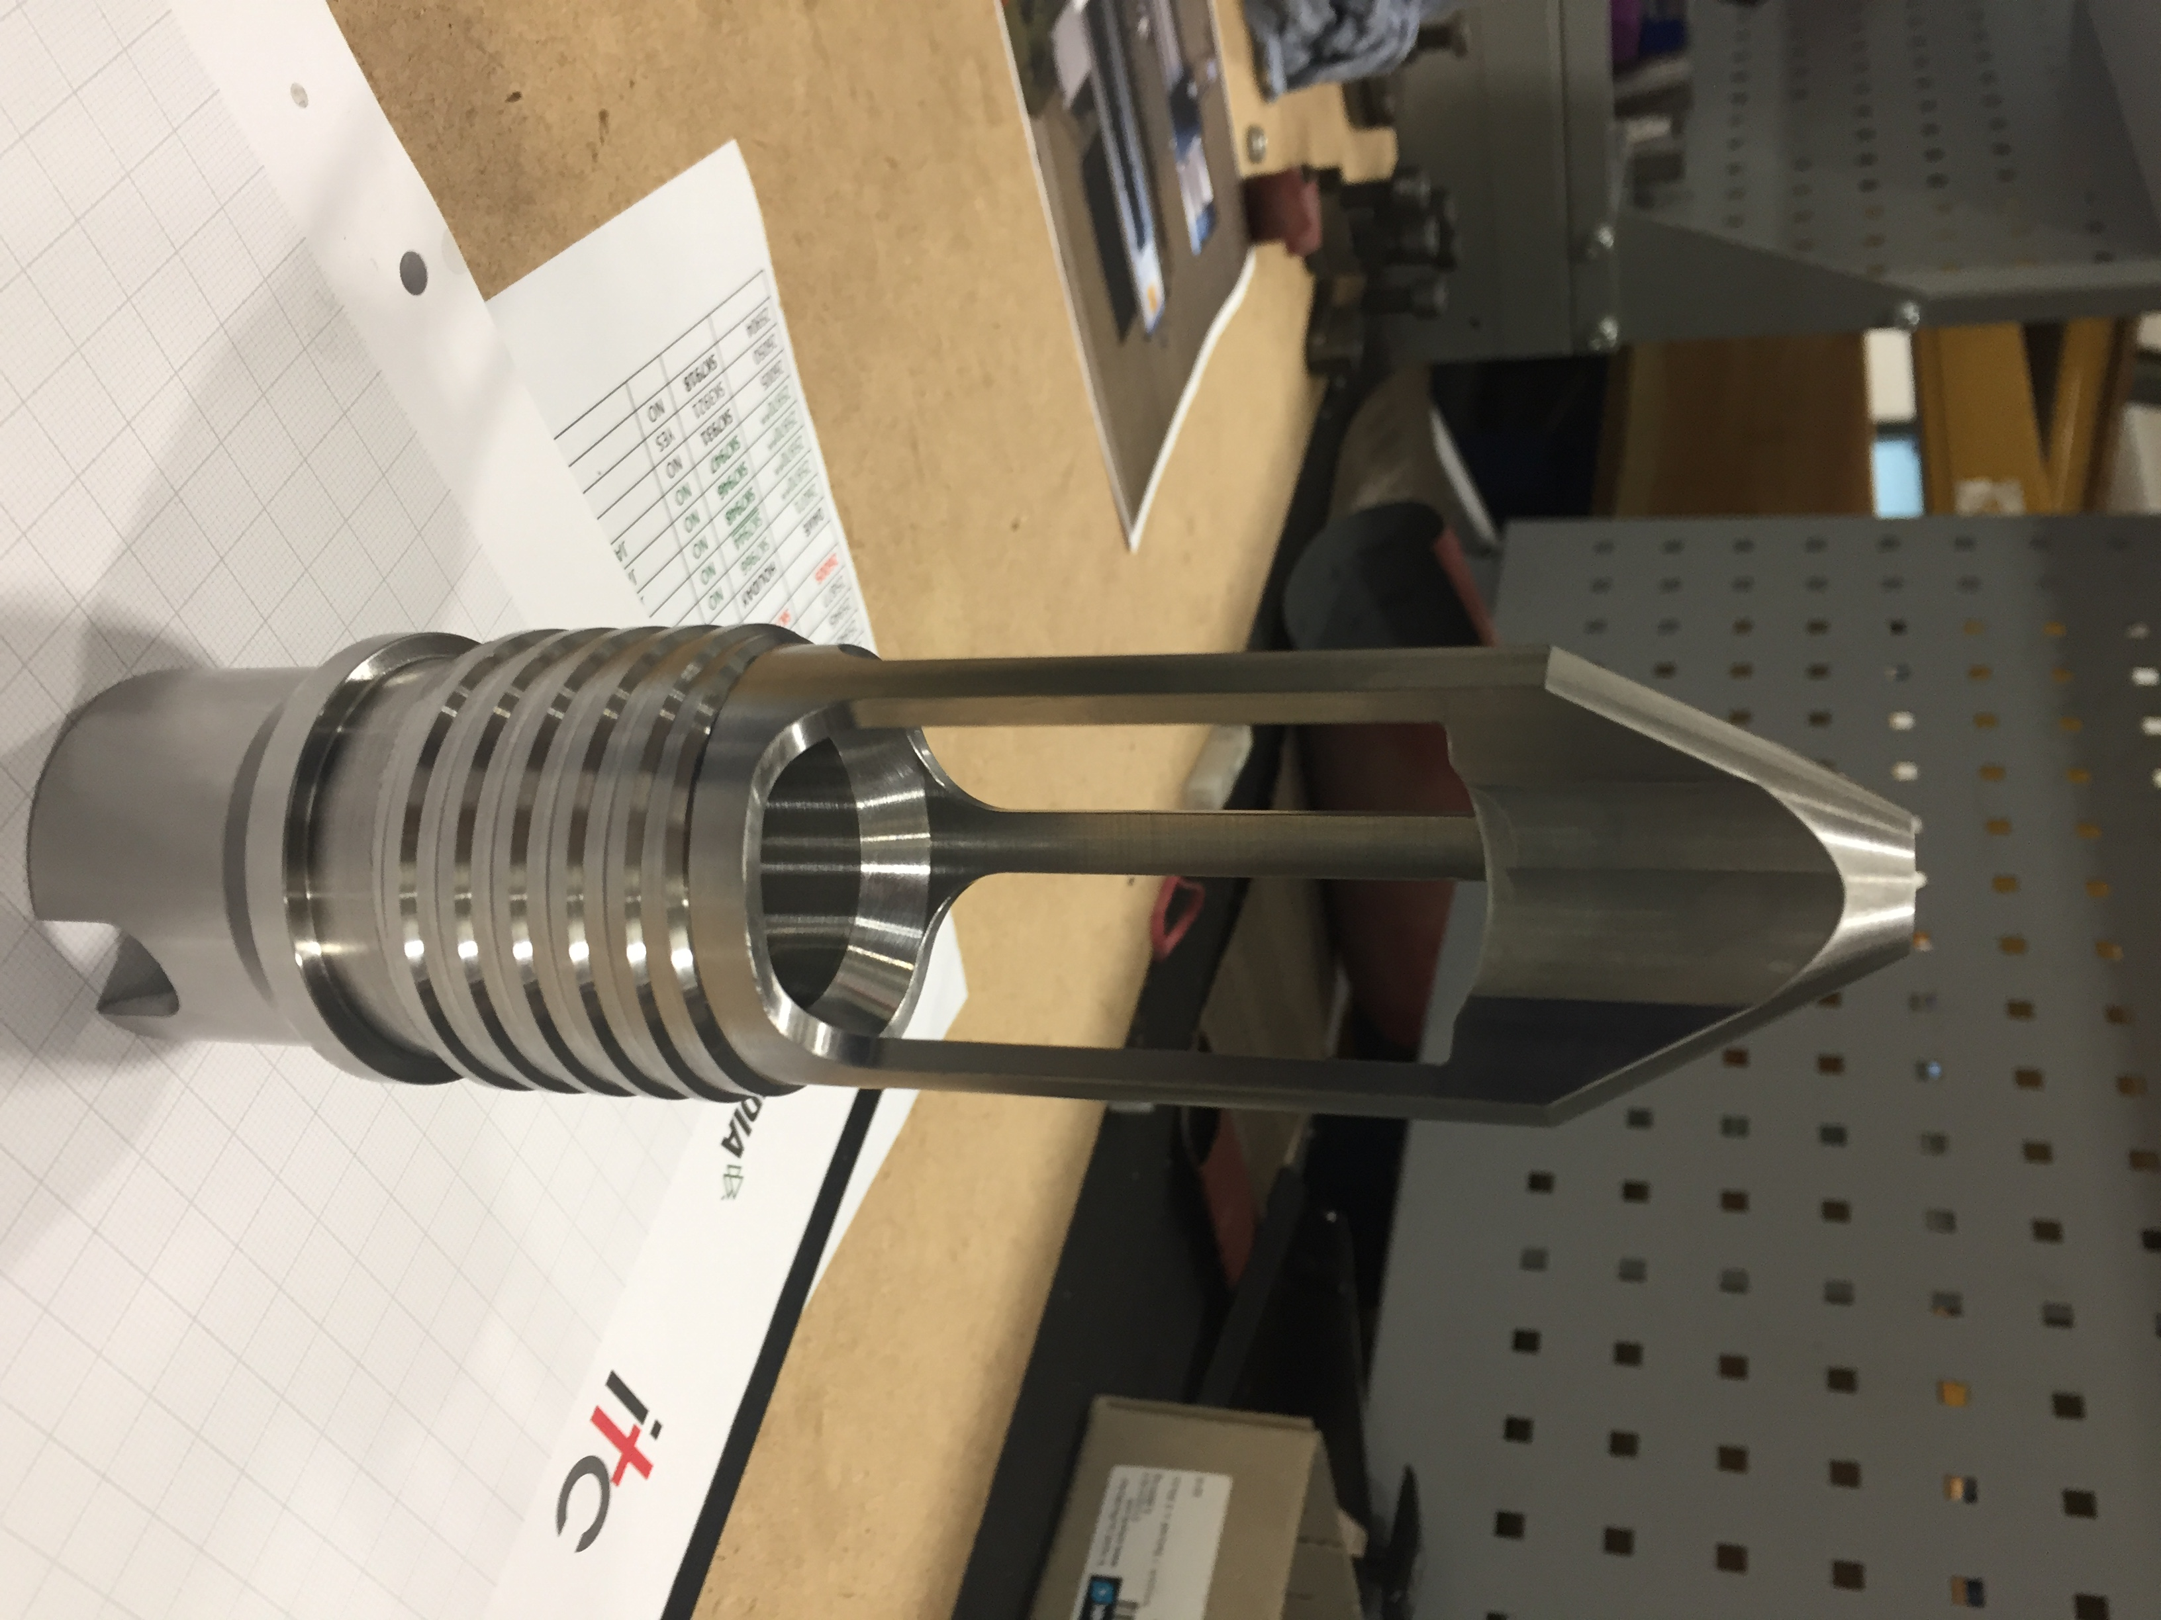
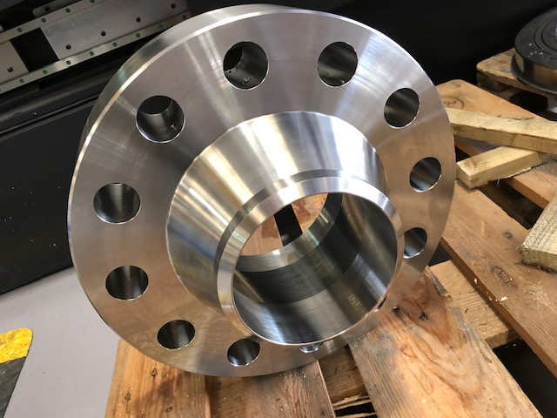
Introduction
Founded in 1970, Chappell Engineering Limited operates from a purpose-built facility of approximately 1500 sqM fully enclosed by high security fencing and access gates subject to 24/7 remote security surveillance.
Recently extended to enable further expansion of its manufacturing capacity, the facility houses an extensive cross section of latest generation Mazak, Doosan and Sodick machine tools supported by a platform of material preparation, heat treatment and finishing capabilities.
In house capabilities (third party certified) include High Pressure Testing and Non-Destructive Examination and a comprehensive inspection and test facility, including two Aberlink CMM’s, material hardness and chemical composition testing.

Slide 3
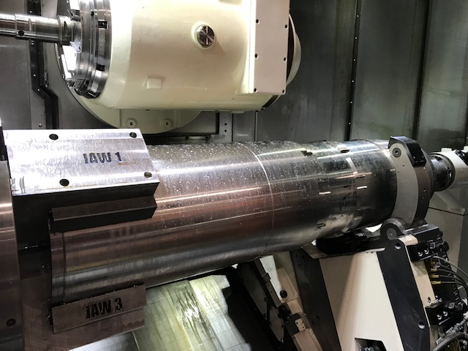
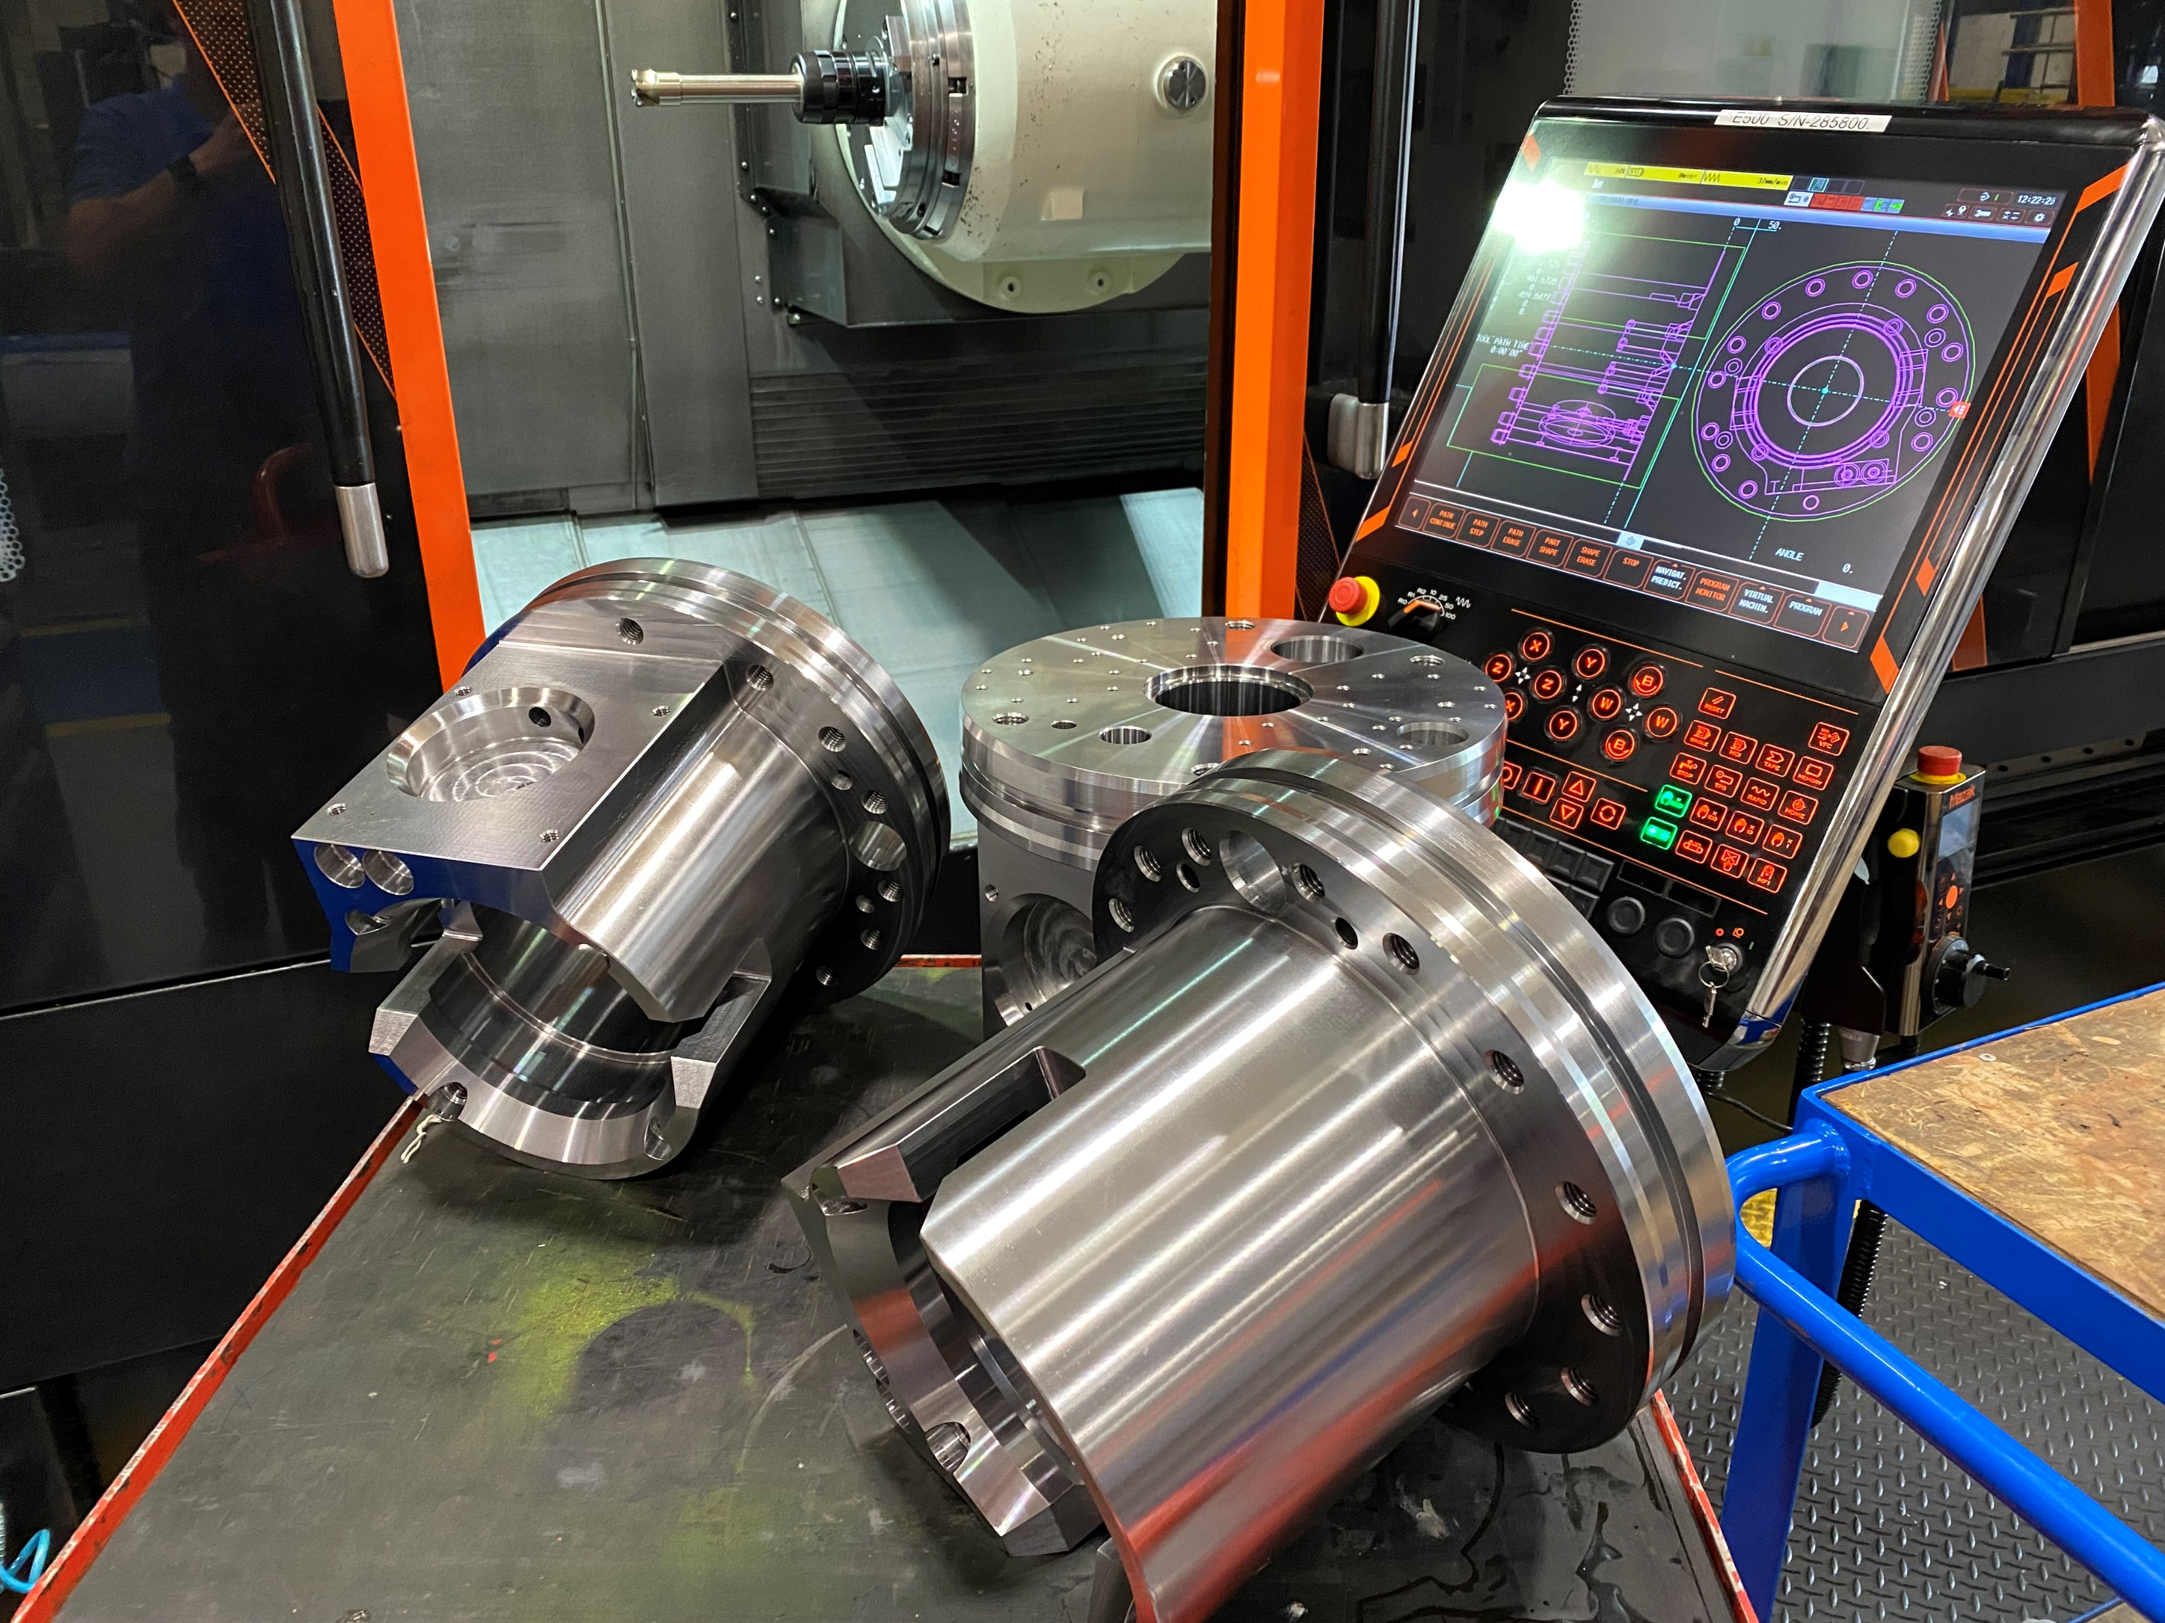
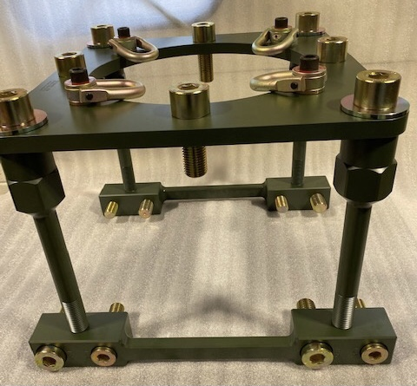
Overview
Chappell Engineering have progressively established themselves in the Oil & Gas Industry Sector as a leader in the manufacture of high value / low volume parts and bespoke assemblies utilizing an exceptional portfolio of machine tool capabilities.
Recognized as a ‘go to’ organization for developmental projects that demand and combine materials (Ferrous, Nonferrous, Polymers and, so called, exotics), specialist coatings, surface treatments and complex and challenging geometrical requirements.
Chappell Engineering utilizes a strong network of accredited specialty service providers for heat treatment, electro-plating, surface treatment, painting and coating to ensure a complete production services offering.
Pull Down Tool for
Oil Field Tree Cap
Multiple Manufactured Parts Assembly
Photograph: Finished Xylan Coated Assembly
Integrex Machine
(Material API6ACRA 718 / ANSI/NACE MR0175)
1400mm Length x 330mm Diameter with 10mm wall thickness
Photograph: Milling ‘Slots’ Detail
Integrex Machine
(Material 4130)
235mm Length x 300mm Diameter with complex geometry
Photograph: Finished Pre-coated Parts

Slide 4
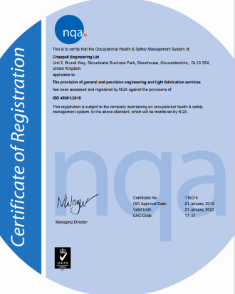
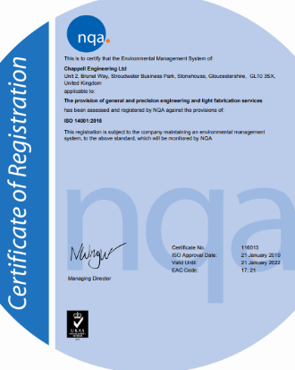
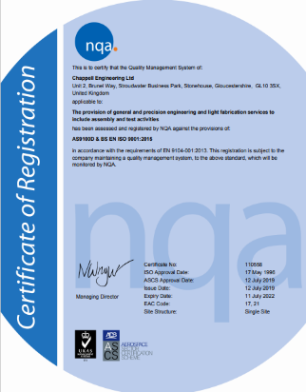
Credentials
Strongly ethical, Chappell Engineering ensures continued adherence with global expectations and responsibilities relating to its customers, its employees and its stakeholders through its business practices and behavior.
Chappell Engineering Limited recognizes its responsibilities. Certified to AS.9100 / ISO.9001 / ISO.45001 and ISO.14001, it employs a highly professional and holistic approach to compliance via its Integrated Management Systems.
Continuous investment in Quality Assurance, Health & Safety and Environmental improvements is made to underpin Chappell Engineering’s commitment to best practice, the health and wellbeing of its employees and to the environment.

Slide 5
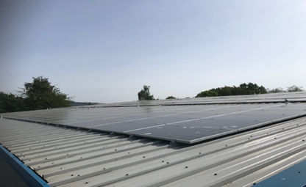
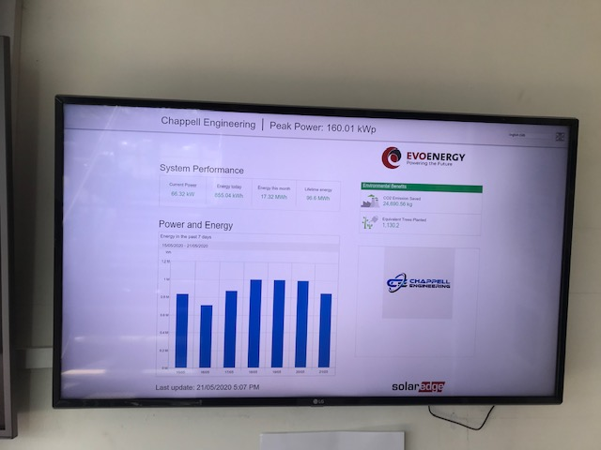
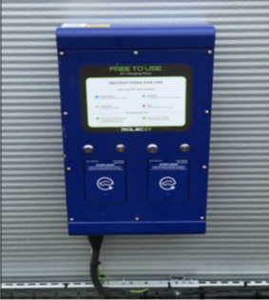
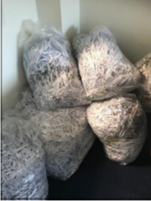
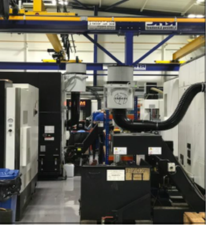
Environmental
Chappell have significantly invested in Solar power providing energy for its facility and, for 2021, is now contributing power back into the grid.
Continuous focus on achieving a carbon neutral status with investment projects including:
Solar panel electricity generation.
Employee vehicle charging points
LED smart lighting.
100% cardboard / paper recycling for product packaging.
Emissions scrubbing technology to remove all oil mist from our factory environment.
Forestry Commission sustainability certified wooden packaging.
Waste segregation and >90% licensed recycling.
Coolant management systems delivering benefits in energy consumption, handling and environmental risk exposure.

Slide 6
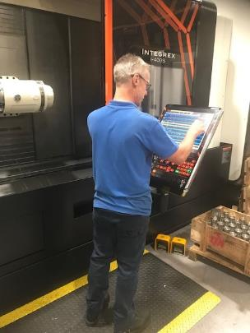
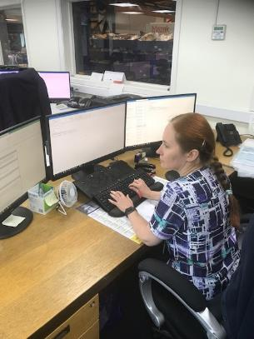
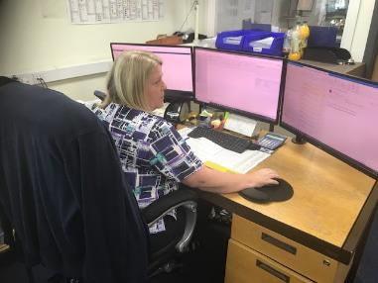
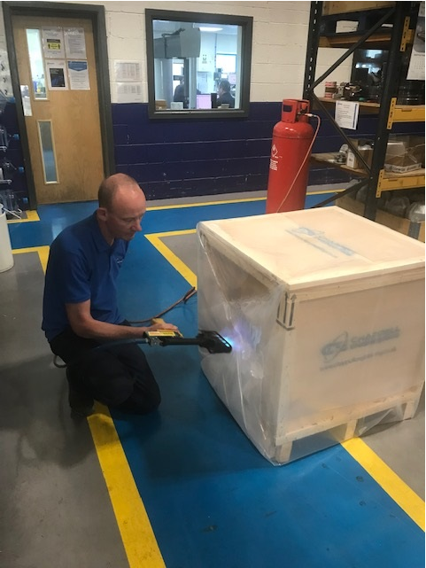
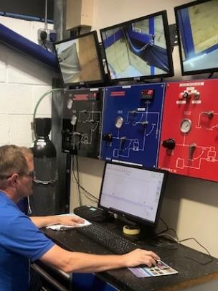
People
At the heart of Chappell Engineering are its people. Experience and knowledge combine to create a team of Programmer / Operators, Inspection / Test Engineers , Management and Support Personnel.
The highest level of customer service is provided daily to more than thirty customers around the world by a team focused on Order Management from inquiry to invoice. With highest quality machined parts at the center of our business Chappell Engineering is dedicated to every facet of product delivery including Third-Party Inspection, New Product Introduction, Material / Test Certification & Traceability, Order Expedition, Packing, Despatch and Logistics.
With a combined experience of 200 years in Mechanical and Production Engineering across a spectrum of industrial sectors, Chappell Engineering’s Management Team continuously provides stewardship, support and vision to ensure the current and future needs of its customers are addressed.

Slide 7
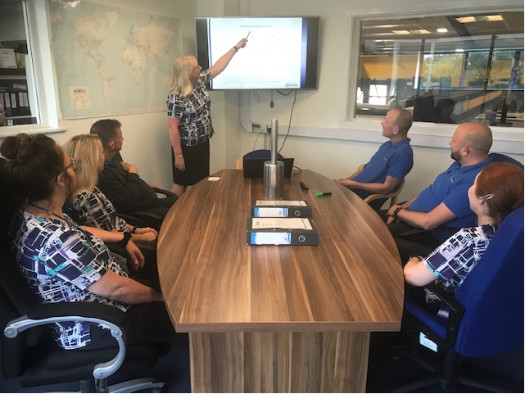
Diversity & Inclusion
Diversity and Inclusion have long been established at Chappell Engineering. Our diverse, multi-national workforce are at the core of our organization, individuals are valued for the unique qualities and perspectives that they bring to our team and our clients.
Equal opportunity for advancement is provided to everybody in a fair and just manner. Chappell Engineering are proud of its participation in the development of young people via sponsorship and engagement of Apprentices.
Chappell Engineering are committed to providing an inclusive work environment where everyone will be welcomed, valued, respected, and supported through its well being and mentoring program.
Chappell Engineering is proud of its record of gender diversity with one third of our employees being female, two thirds of these are appointed to the Executive Leadership Team and half are at Director level or above.

Slide 8
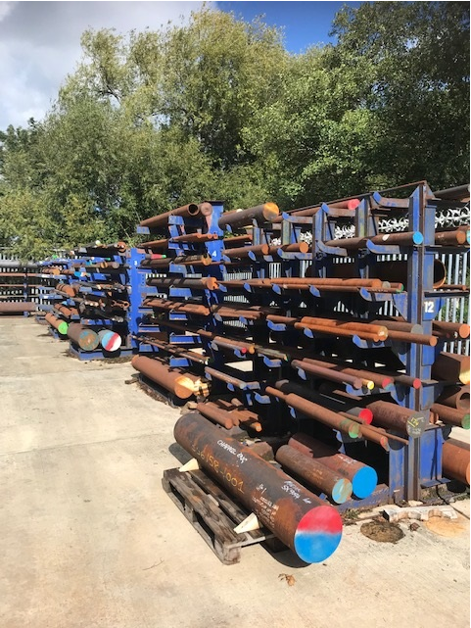
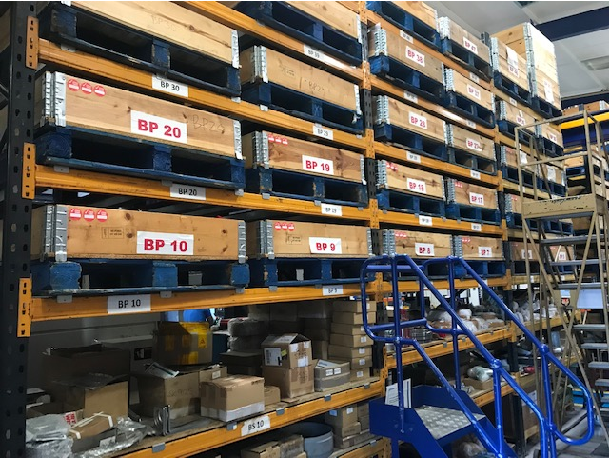
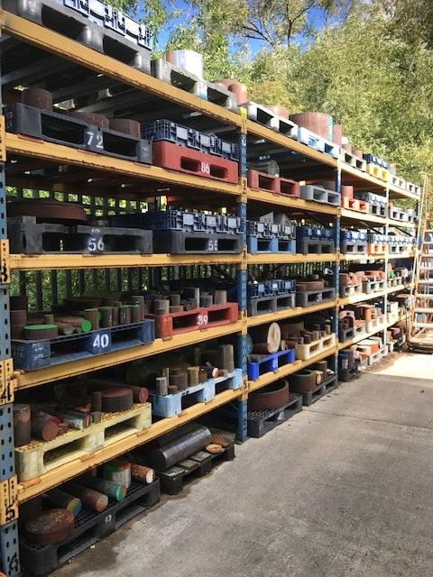
Inventory Management
Global supply chain issues, long delays for materials availability, consequential lead times for deliveries and fluctuating costs are currently presenting our industry sector with an additional set of operational challenges.
Chappell Engineering maintains an extensive portfolio of raw materials in stock endeavoring to minimise challenges associated with raw material availability and fluctuating materials pricing.
In addition, working in collaboration with its customers, Chappell Engineering has long retained a proactive strategy of economic production whereby high running parts are produced to economic batch sizes to minimise set up times / cost.
Excess finished parts are retained in dedicated high bay storage, inventory managed and are available for repeat orders resulting in considerably reduced lead times and very competitive pricing.

Slide 9
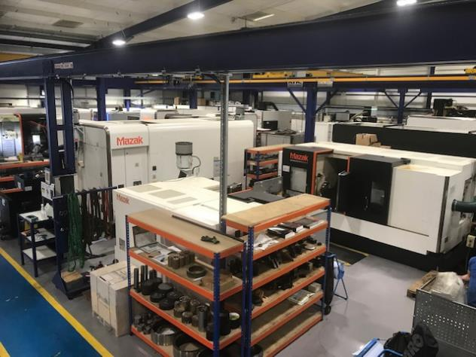
Machines: Introduction
Chappell Engineering have continually invested in latest generation machine tools developing close relationships with leading machine tool manufacturers such as Mazak and Doosan ensuring the highest levels of service and support.
It is imperative that machine capabilities keep pace with customer expectations regarding product geometry, features and, of course cost and turnaround time. Chappell Engineering endeavor to anticipate the evolution in requirements and to ensure its capabilities remain at the forefront of technology.
Recognizing the need for accelerated lead times and an expectation to minimise environmental footprint, Chappell Engineering have progressively invested in ‘in-house’ capabilities to provide a seamless service to its customers including facilities for NDE, Pressure Testing, Shot Blasting, Stress Relieving and Clean Room Assembly.

Slide 10
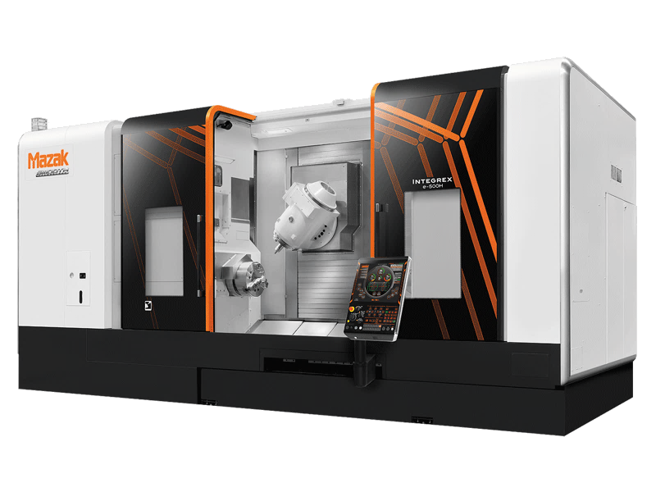
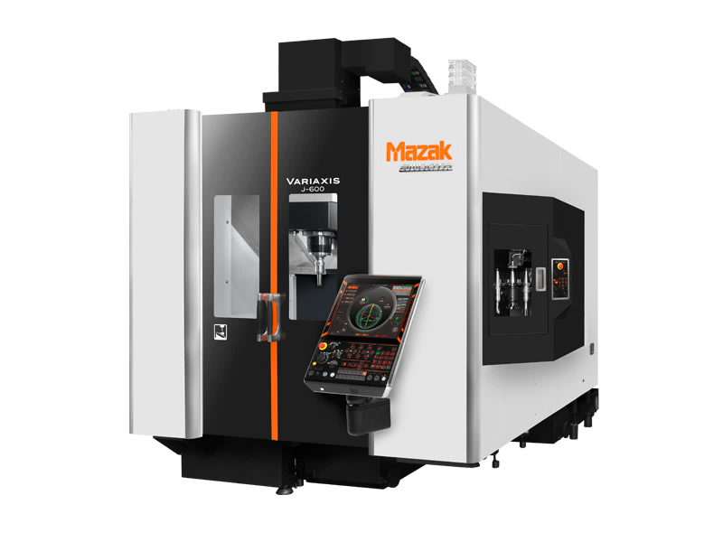
Capabilities Matrix : Turn & Mill
Turn/Mill Machines | Quantity | Capabilities Description
Mazak 250 II MY | 2 | Number of Axis: 3 Length (Min & Max): Max 500mm Spindle Thru Cap Diameter (max): 500mm
Mazak 350 II MY | 2 | Number of Axis: 3 Length (Min & Max): Max 1600mm Spindle Thru Cap Diameter (max): 100mm
Mazak 450 II MY | 1 | Number of Axis: 3 Length (Min & Max): Max 2000mm Spindle Thru Cap Diameter (max): 0mm cap (solid chuck)
Mazak I400 Twin Chuck Integrex Machining Centre + 72 tool carrousel | 3 | Number of Axis: 5 Length (Min & Max): Max 1500mm Spindle Thru Cap Diameter (max): 100mm
Mazak I800 Vertical Machining Centre + With Turning Capability's 40 tool magazine | 1 | Number of Axis: 5 Length (Min & Max): Max 800/1000mm Width (Min & Max): Max 750mm Height (Min & Max): Max 500mm
Mazak E500 Integrex Full CNC Machining Centre + 40 tool magazine | 1 | Number of Axis: 5 Length (Min & Max): Max 3000mm Spindle Thru Cap Diameter (max): 60mm

Slide 11
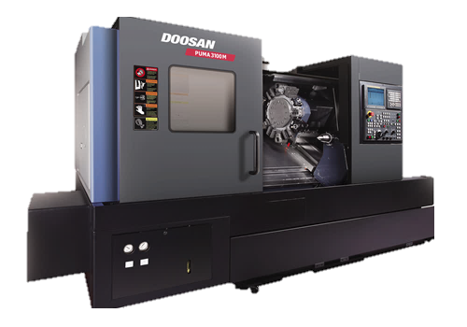
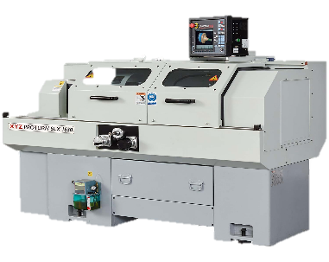
Capabilities Matrix : Turning
Turning Machines | Quantity | Capabilities Description
Doosan 2100 Live Tooling Lathe | 1 | Length Between Centers: 550mm Diameter (Min & Max): Min 10mm, Max 200mm Number of Axis: 3 Spindle Thru Cap Diameter (max): 50mm
Doosan 2600 Live Tooling Lathe | 2 | Length Between Centers: 650mm Diameter (Min & Max): Min 20mm, Max 254mm Number of Axis: 3 Spindle Thru Cap Diameter (max): 80mm
Doosan 3100 Live Tooling Lathe | 1 | Length Between Centers: 780mm Diameter (Min & Max): Min 20mm, Max 300mm Number of Axis: 3 Spindle Thru Cap Diameter (max): 100mm
XYZ 425 SLY Manual or CNC Lathe | 1 | Length Between Centers: 1000mm Diameter (Min & Max): Min 20mm, Max 300mm Number of Axis: 2 Spindle Thru Cap Diameter (max): 90mm
XYZ 1630 Manual or CNC Lathe | 1 | Length Between Centers: 500mm Diameter (Min & Max): Max 200mm Number of Axis: 2 Spindle Thru Cap Diameter (max): 50mm

Slide 12
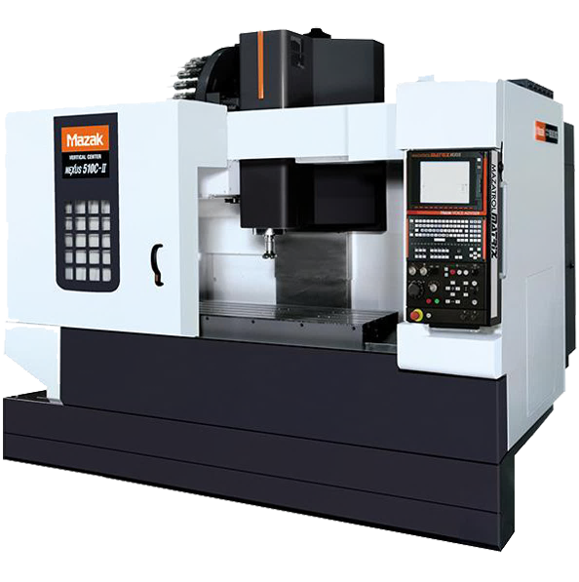
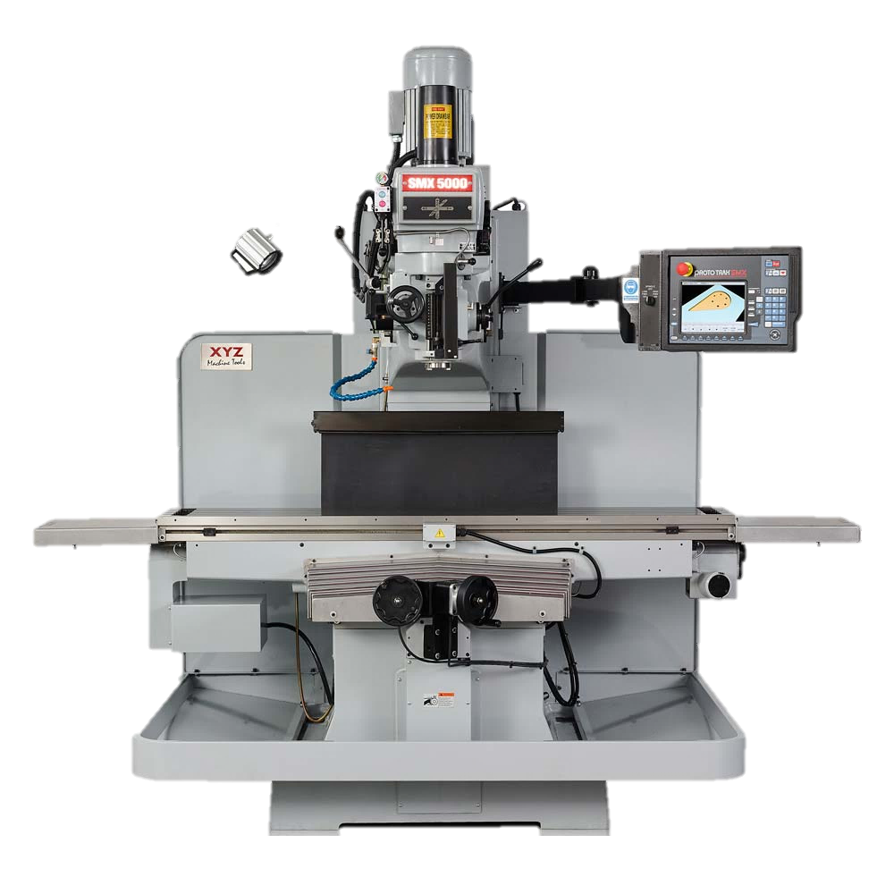
Capabilities Matrix : Milling
Milling Machines | Quantity | Capabilities Description
Mazak J600 Integrex Full CNC Machining Centre | 1 | Number of Axis: 5 Length: 550mm Width: 750mm Height: 450mm Weight: 500kg Max Dia: 730mm
XYZ SMX 3500 | 1 | Number of Axis: 3 Length (Min & Max): Max 700mm Width (Min & Max): Max 400mm Height (Min & Max): Max 450mm
XYZ SMX 5000 | 1 | Number of Axis: 3 Length (Min & Max): Max 1400mm Width (Min & Max): Max 500mm Height (Min & Max): Max 450mm
Mazak 510 + 30 tool magazine | 1 | Number of Axis: 3 Length (Min & Max): Max 1300mm Width (Min & Max): Max 550mm Height (Min & Max): Max 570mm

Slide 13
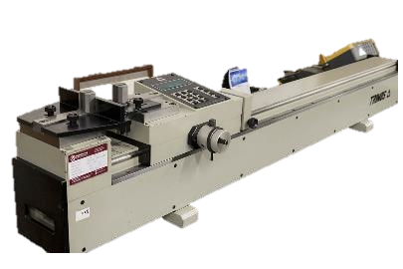
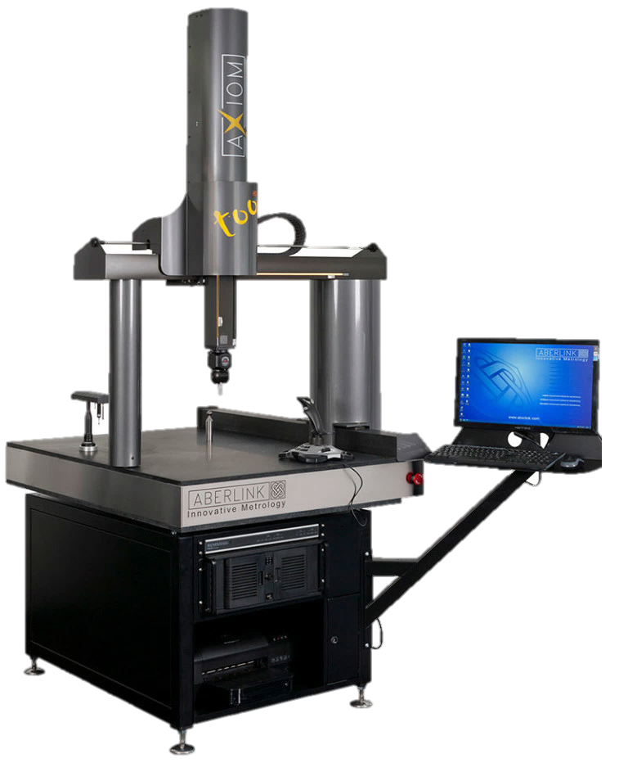
Capabilities Matrix : Inspection
Type of Inspections | Quantity | Limitations
Pressure testing | 1 | 2000 KG weight Max. Water - 24000 psi Max, Nitrogen - 20000 psi
Dye/Liquid Penetrant Inspection | 1
Magnetic Particle Examination | 1
Ultrasonic Examination | 1
PMI Gun (material analysis) XL2 800 | 1
Hardness Inspection | 5 | 2 x Avery - station 3 x Foundrax - portable
CMM Machine | 2 | Zenith TOO - Max Size: 1000mm x1000mm x 800mm. Max Load: 1500kg Axiom TOO - Max Size: 640mm x900mm x500mm. Max Load: 300kg
Trimos TELMA 600 | 1 | Max length 600mm

Slide 14
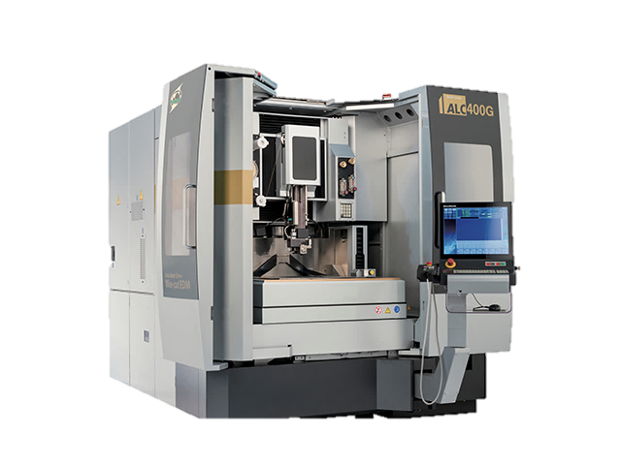
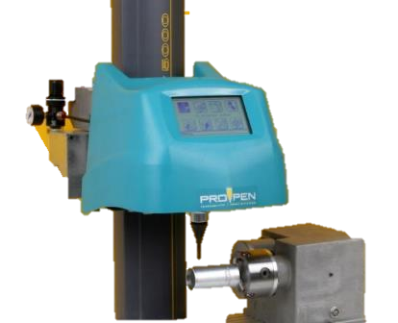
Capabilities Matrix : Other
Other Capabilities | Quantity | Max Capability
Normalising oven (Carbolite furnace) | 1 | 600mmHx550mmWx900mmL or 600mm dia x 900mmL
Wire cutting (EDM) | 2 | 1 - Sodick Premium ALC600G 600mmWx400mmLx500mmH 1 - Sodick Premium ALC400G- 400mmWx320mmLx250mmH
Marking & Engraving | 2 | PRO PEN P5000 + 1 3rd Axis Vibro engraving, Labels + Manual stamping
Dedicated Clean Room assembly facilities | 1

Slide 15
Chappell Engineering
Proven heritage of 50 years in one of the worlds most demanding industrial sectors.
Continuous investment to ensure expectations and capabilities are and remain aligned.
Highly experienced and skilled team focused on competitively delivering on commitments for Quality, Cost and Delivery.
Comprehensive network of accredited vendors for heat treatment, electroplating and specialist coatings.
Extended scope of in-house capabilities delivering value added services without risk and delay.
Strong and demonstratable credentials in Quality, Health& Safety and Environment.
Management culture based on traditional values and a willingness to work in partnership with its customers.
Strategic positioning next to the M5 providing smooth transportation links for road, rail and air.

Slide 16
Unit 2 Brunel Way
Stroudwater Business Park
Stonehouse
Gloucestershire
GL10 3SX, United Kingdom
+44 (0) 1453 825 613
enquiries@chappelleng.com
www.chappelleng.com
Contacts:
Nigel Sealey:
Business Development
Sharon Phillips:
CEO
Jim Chappell:
Managing Director
Traditional Values : Tomorrows Technology

